Slide 1
Progress Meeting 01/05/2020

Slide 2
Progress
Found the error
Minor error in the system derivation
Validated my code with Facchini
Produced a convergence plot

Slide 3
Validation approach using Facchini
Single unstable eigenmode for Fh = 1; alpha = 0.8; beta = 5; Re = 1000:
Facchini -> Real(omega) = 0 and Imag(omega) > 0
OS_SQ_Stratified_Solver -> 0.0000 + 0.0127i

Slide 4
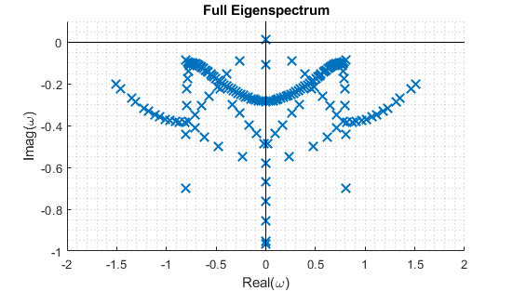
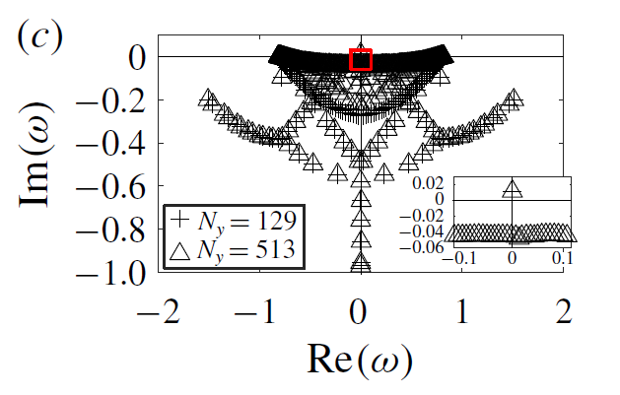
Validation approach using Facchini
Full eigenspectrum for N = 129; Fh = 1; alpha = 0.8; beta = 5; Re = 1000:

Slide 5
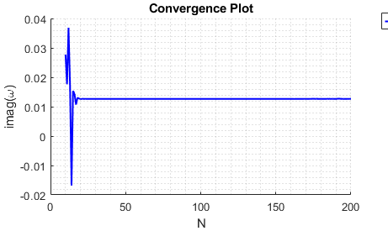
Convergence of grid points, N
Fh = 1; alpha = 0.8; beta = 5; Re = 1000; theta = 90

